Slide 1
EC Research Project
Final Presentation
GROUP-D
Nithin Holla
Klaus Ondrag
Leonardo Romor
Notes:
Nithin

Slide 2
OVERVIEW
Environments
Experimental Setup
Results
Other Contributions
Conclusion and Future Work
Notes:
Nithin

Slide 3
EXPERIMENT 1
Notes:
Nithin

Slide 4
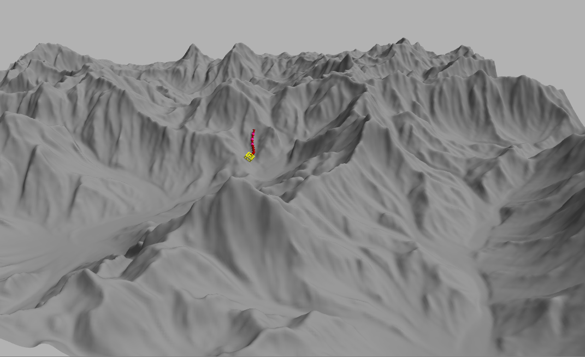
THE MOUNTAIN ENVIRONMENT
Challenging environment
Limbs would ideally help in ascending/descending
Expect complex morphologies
Notes:
Nithin

Slide 5
Description
Environment | Mountain
No. of Generations | 50
Population size | 50
Evaluation period | 30s
Fitness function | Speed
No. of runs | 10
Notes:
Klaus

Slide 6
Results
Population converged to snakes
No statistical significance for any of the descriptors
Notes:
Nithin

Slide 7
EXPERIMENT 2
Notes:
Nithin

Slide 8
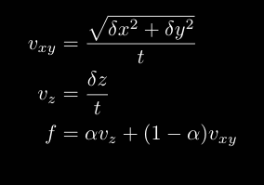
A new fitness function
Need to award vertical movement
Weighted mean of horizontal and vertical displacement velocity
Parameter 𝛂 controls importance of vertical velocity
Notes:
Nithin

Slide 9
Description
Environment | Mountain
No. of Generations | 50
Population size | 50
Evaluation period | 60s
Fitness function | Modified speed with 𝛂 = 0.9
No. of runs | 5
Notes:
Klaus

Slide 10
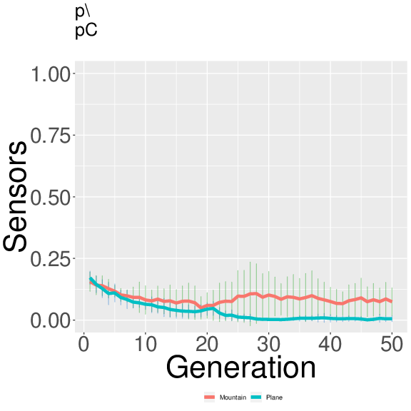
Results
Population converged to snakes again
Almost all descriptors insignificant, so not promising to pursue
Greater number of sensors utilized - significant
Perhaps helps them avoid obstacles
Bias is strong
No learning - so controller unfit for managing multiple limbs
Descriptor | Wilcoxon p value
Branching | 0.423
Connectivity 1 | 0.222
Connectivity 2 | 0.057
Coverage | 0.834
Effective joints | 0.294
Length ratio | 0.690
Sensors | 0.017
Symmetry | 0.797
Total components | 0.222
Notes:
Nithin

Slide 11
EXPERIMENT 3
Notes:
Klaus

Slide 12
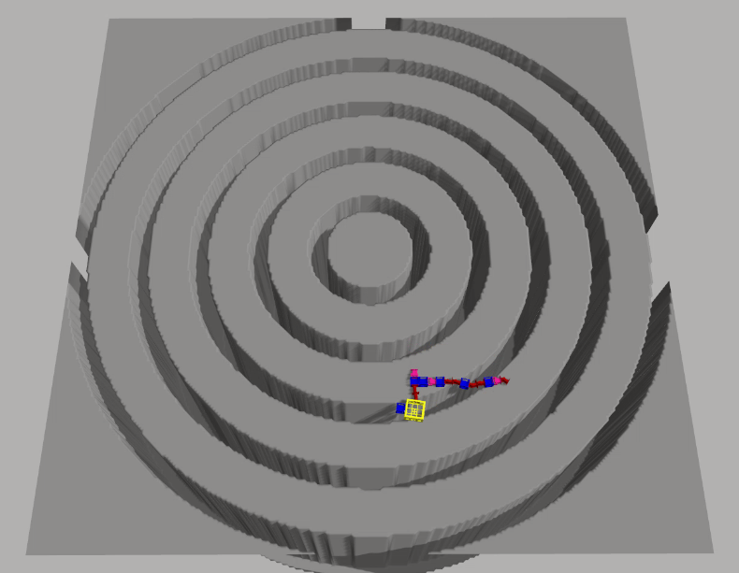
Description
Environment | Concentric trenches
No. of Generations | 50
Population size | 50
Evaluation period | 120s
Fitness function | Speed
No. of runs | 10
Notes:
Klaus

Slide 13
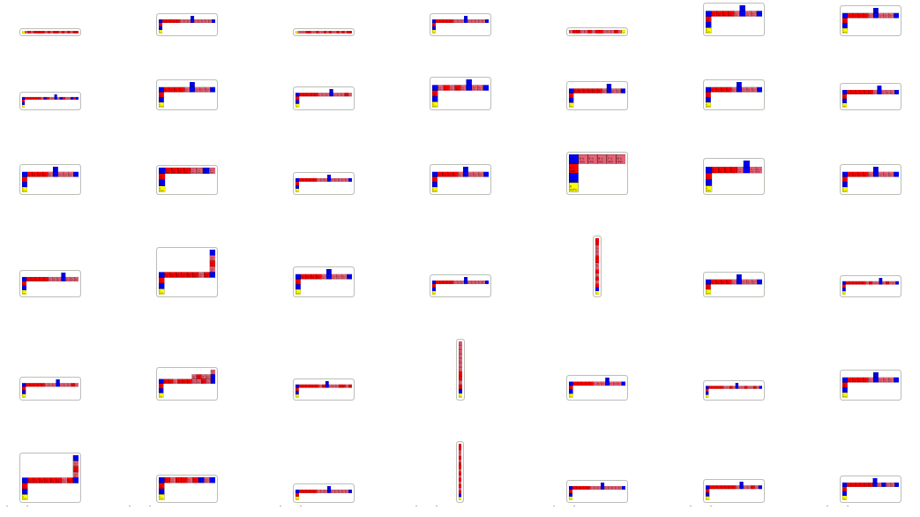
Results

Slide 14
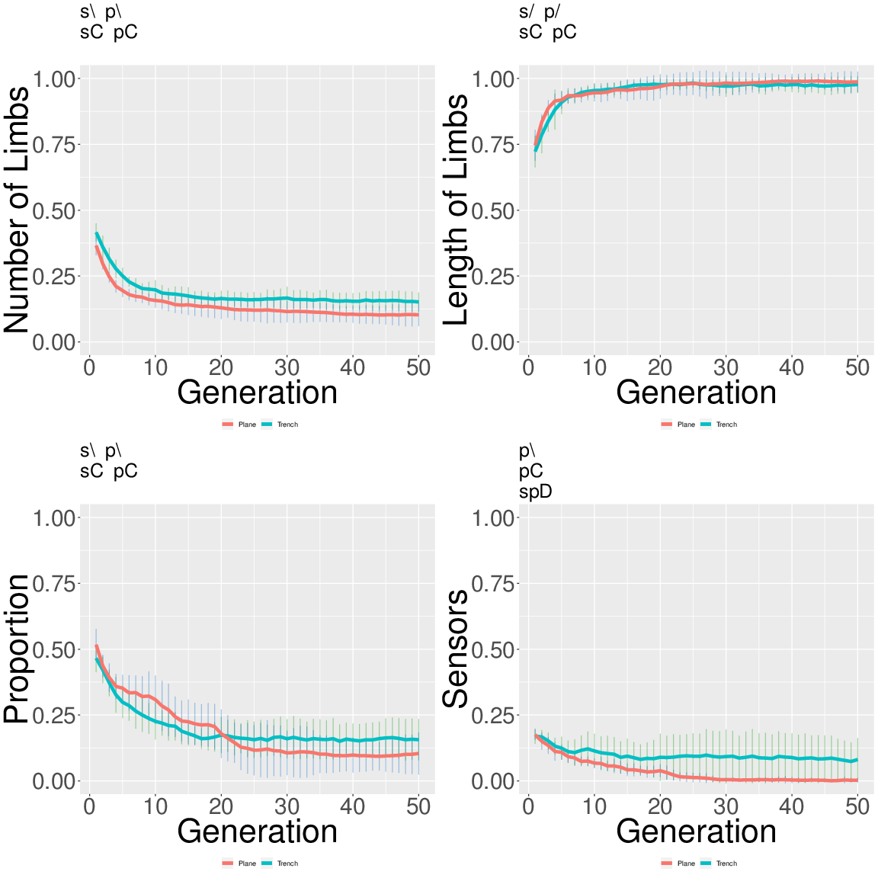
Results
Descriptor | Wilcoxon p value
Branching | 0.368
Connectivity 1 | 0.023
Connectivity 2 | 0.043
Coverage | 0.250
Effective joints | 0.237
Length ratio | 0.011
Sensors | 0.002
Symmetry | 0.214
Total components | 0.052
Notes:
Klaus

Slide 15
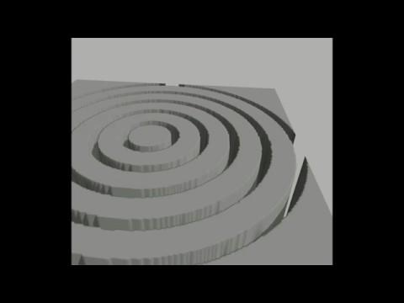
L-Snakes
Nov2018

Slide 16
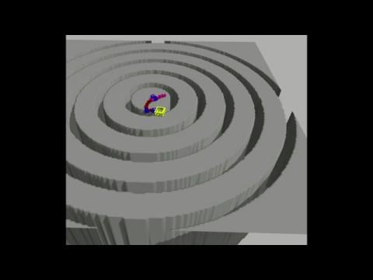
L-Snakes
Jan2019

Slide 17
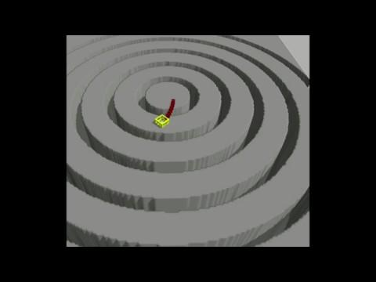
I-Snakes

Slide 18
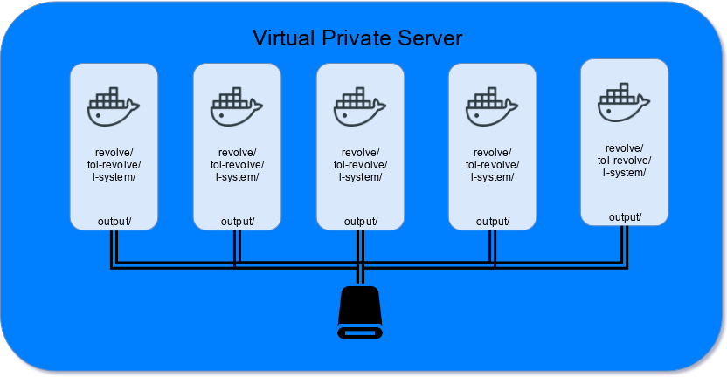
OTHER CONTRIBUTIONS
High-throughput system
Multiple simulations running
concurrently on sandboxed
environments:
Automatic installation of
the required dependencies
Highly customizable
simulations thanks to
docker volumes.
Notes:
Leonardo

Slide 19
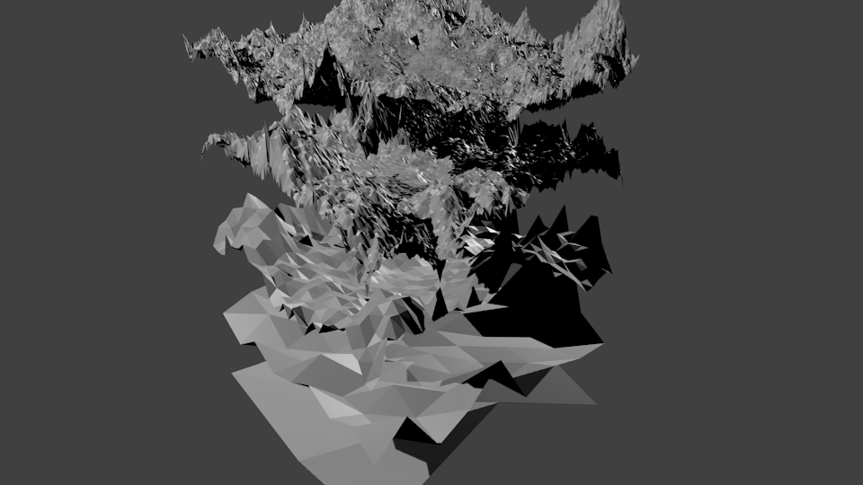
Procedural terrain generation
Notes:
Leonardo

Slide 20
CONCLUSION AND FUTURE WORK
Run experiments with 100 generations / 100 population size / 10 times
Introduce scaffolding for both mountain and trench environments
Improve the high-throughput system
Incorporate learning
Notes:
Leonardo

Slide 21
Thank you!
Notes:
Leonardo

